Slide 1


Reviewing the Standards for Wind-Driven Rain (WDR) Intrusion through Tracks of Sliding Glass Door Systems (SGDs) during Hurricanes
PI: Omar Nofal, Ph.D.
Co-PI: Arindam Chowdhury, Ph.D.
Co-PI: Ryan A. Catarelli, Ph.D.
Assistant Professor
Professor
Research Assistant Scientist
Florida International University
Florida International University
University of Florida
1

Slide 2

Introduction
In Florida's Miami-Dade County, standards for protecting doors and windows against wind-borne debris were set in response to Hurricane Andrew. As to the current Florida Building Code, 6th edition, glazed openings in structures located in wind-borne debris zones must either be impact-resistant or have an impact-resistant covering (shutters) installed to protect them.
The FBC has been entrusted with carrying out a thorough investigation on requirements to prevent water infiltration through sliding glass door tracks, including examining devices intended to minimize or prevent water intrusion, following Section 32 of HB 10 21-2024 [6].
SGDs can span a big aperture and provide lots of natural light and ventilation because of their multipaneled construction. Breaking through such a large opening during a windstorm, however, might cause extensive damage to SGDs from debris impact and water ingress.
2

Slide 3
Background
The Florida Building Commission (FBC) has been authorized by Section 32 of HB 10 21–2024 to conduct a study on standards to investigate and identify strategies to lessen or prevent water intrusion through sliding glass door tracks, including taking into account devices intended to further attenuate such water intrusion.
Wind-driven rain (WDR) infiltration may cause significant interior damage, property loss, and health risks due to mold and mildew, as seen by previous storms. Sliding glass doors (SGDs) are particularly susceptible to this kind of disruption. Right now, depending on the duration of the storm, the intensity of the rain, and the wind pressure applied to the door systems, different mitigation strategies may demonstrate varying levels of effectiveness.
3

Slide 4
Motivation and Purpose of the Study
The objective of this review is to enhance building resilience and occupant safety through the mitigation of water intrusion risks in hurricane-prone areas, the maintenance of standards in line with the increasing intensity of hurricanes because of climate change, and the promotion of better code development and compliance for regulators, builders, and architects.
Additionally, the literature evaluation will point out any holes or flaws in the SGDs testing technique that has been used and provide suggestions for strengthening the standards to strengthen sliding glass door systems' resistance to WDR.
4

Slide 5
Scope of Work
Task 1: Formation of A Technical Advisory Committee (TAC)
The objective of this task is to form a technical advisory committee (TAC) to guide the research program.
TAC members shall represent different groups of practitioners and academics.
This may include representatives from the fenestration and building component and cladding manufacturing industries, testing laboratories, architectural firms, engineering firms, and code officials.
The role of this TAC will be to evaluate various methods of WDR testing and inform revisions to current testing protocols for studying WDR intrusion through tracks of sliding glass door systems.
The TAC shall convene by video conference on a minimum of five occasions.
5

Slide 6
Scope of Work
A 15-person Technical Advisory Committee (TAC) was established by the PI and Co-PIs. On September 12, 2024, the TAC met for the first time to address the influence of sample sizes on rainwater intrusion, limits of the present pass/fail water intrusion criteria, and plans for literature reviews.
The TAC contributed significantly to the improvement of sliding glass door standards and possible modifications to the 15% positive Design Pressure (DP) rating for WDR, including field findings from Hurricane Ian.
6

Slide 7
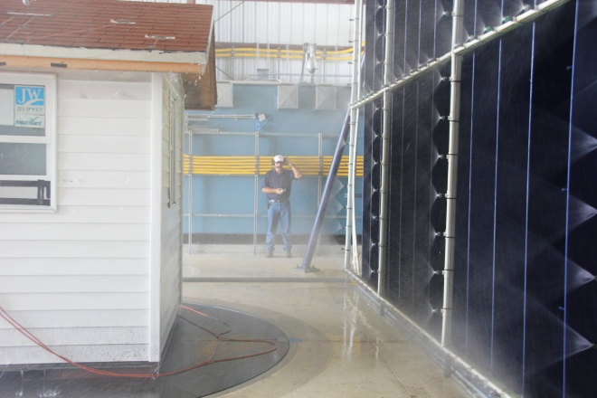
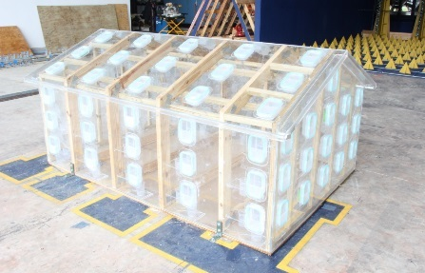
Methodology
Task 2: Reviewing Existing Literature, Reports, and Standards
Based on the recommendations from the technical advisory committee, FIU-CEE, and UF-CEE shall review current testing standards and relevant literature and reports related to WDR intrusion through tracks of sliding glass doors.
FIU-CEE shall research studies and test results on WDR experiments previously performed at the NHERI Wall of Wind Experimental Facility (WOW EF) at FIU and other facilities including the University of Florida NHERI EF.
FIU-CEE shall provide a summary of the literature and testing review outlining the recommendations and conclusions of each research study reviewed.
Wind-Driven Rain Test of Full-Scale Model
Large-Scale Model with Rain Gauges
7

Slide 8
Scope of Work
Using analytical and empirical techniques, as well as previous research conducted by Chowdhury et al. at FIU, the study attempts to evaluate wind-driven water intrusion via sliding glass doors in residential mid-rise structures.
Testing is conducted by Florida Building Code requirements, such as TAS 201, 202, and 203, which gauge door performance, impact resistance, and water penetration during hurricane circumstances.
However, since they depend on static pressure and ignore the dynamic forces of wind and rain during a hurricane, existing testing methods—particularly TAS 202—are insufficient for assessing real-world water resistance.
Chowdhury, A. G., Erwin, J., & Vutukuru, K. S. (2021). Quantification of wind driven rain (wdr) intrusion through shuttered sliding glass door systems final report. https://doi.org/10.13140/RG.2.2.36806.86081
8

Slide 9
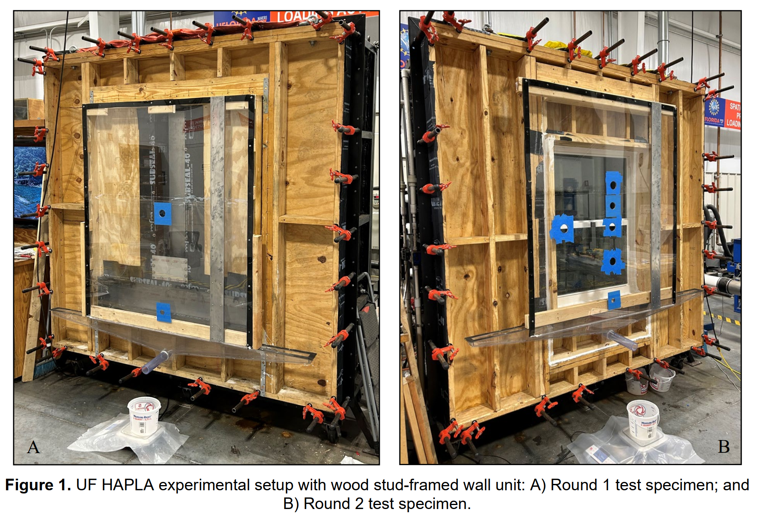
Methodology
Task 3: Formulate Recommendations
In collaboration with the TAC and based on the literature review conducted under Item b, FIU-CEE shall develop recommendations regarding the applicability of the existing industry standards in testing WDR intrusion through tracks of sliding glass doors and evaluation of efficiency of mitigation devices and determine whether modifications and/or new protocols are needed for improved testing and evaluation.
9

Slide 10
Methodology
Expert Consultant
FIU - CEE shall consult with the University of Florida and Dr. Catarelli shall serve as a consultant over the life of this project.
The University of Florida consultant will assist in the standards review based on the previous testing to the sliding glass doors conducted at the Powell Family Structures and Materials Laboratory at University of Florida.
Dr. Catarelli will also help in the forming of TAC.
The team will continue to meet with the TAC for at least another 4 meetings over the course of the next two months to track the progress of the literature review. The focus will be on reviewing the current standards and the reports recommended by the TAC.
10

Slide 11
Budget
11

Slide 12
References
Chowdhury, A. G., Erwin, J., & Vutukuru, K. S. (2021). Quantification of wind driven rain (wdr) intrusion through shuttered sliding glass door systems final report. https://doi.org/10.13140/RG.2.2.36806.86081
International Code Council, Inc. (2017). “Testing Application Standard (TAS) 201-94 Impact Test Procedures.” 2017 Florida Building Code—Test Protocols for High Velocity Hurricane Zone, 978-1-60983-688-7
International Code Council, Inc. (2017). “Testing Application Standard (TAS) 202-94 Criteria for Testing Impact and Nonimpact Resistant Building Envelope Components Using Uniform Static Air Pressure” 2017 Florida Building Code—Test Protocols for High Velocity Hurricane Zone, 978-1-60983-688-7.
International Code Council, Inc. (2017). “Testing Application Standard (TAS) 203-94 Criteria for Testing Products Subject to Cyclic Wind Pressure Loading” 2017 Florida Building Code— Test Protocols for High Velocity(Lopez, 2009) Hurricane Zone, 978-1-60983-688-7.
Catarelli, R. A., & Phillips, B. M. (2023) Final Report for Project Entitled: Assessing the Need to Modernize Water Penetration Resistance Test Procedures PO Number C07078 Presented to the Florida Building Commission State of Florida Department of Business and Professional Regulation Principal Investigator.
Florida Senate. (2024). Bill 1178: Property insurance—2024 regular session. https://www.flsenate.gov/Session/Bill/2024/01178
12

Slide 13
Thank You
13

